Slide 1
CHAPTER 15
Introduction to Genetic Algorithm

Slide 2
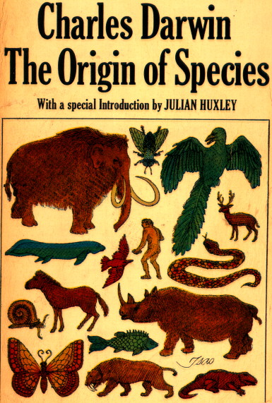
General Introduction to GAs
  Genetic algorithms (GAs) are a technique to
  solve problems which need optimization.
  GAs are a subclass of Evolutionary Computing and are random search algorithms.
  GAs are based on Darwin’s theory of evolution.
  History of GAs:
    Evolutionary computing evolved in the 1960s.
    GAs were created by John Holland in the mid-1970s.

Slide 3
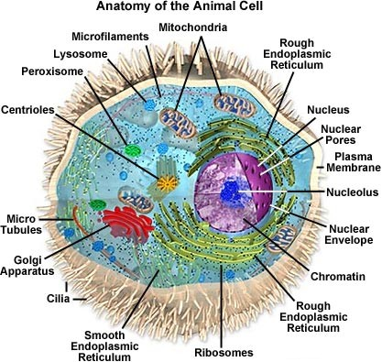
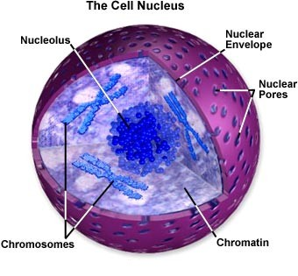
Biological Background (1) – The Cell
  The center of this all is the cell nucleus.
  The nucleus contains the genetic information.

Slide 4
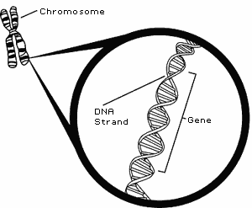
Biological Background (2) – Chromosomes
  Genetic information is stored in the chromosomes.
  Each chromosome is build of DNA (Deoxyribonucleic acid).
  Chromosomes in humans form pairs.
  There are 23 pairs.
  The chromosome is divided in parts: genes.
  Genes code for properties.
  The posibilities of the genes for one property is called: allele.
  Every gene has an unique position on the chromosome: locus.

Slide 5
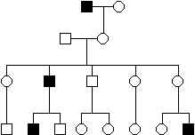
Biological Background (3) – Genetics
  The entire combination of genes is called genotype.
  A genotype develops into a phenotype.
  Alleles can be either dominant or recessive.
  Dominant alleles will always express from the genotype to the fenotype.
  Recessive alleles can survive in the population for many generations without being expressed.

Slide 6
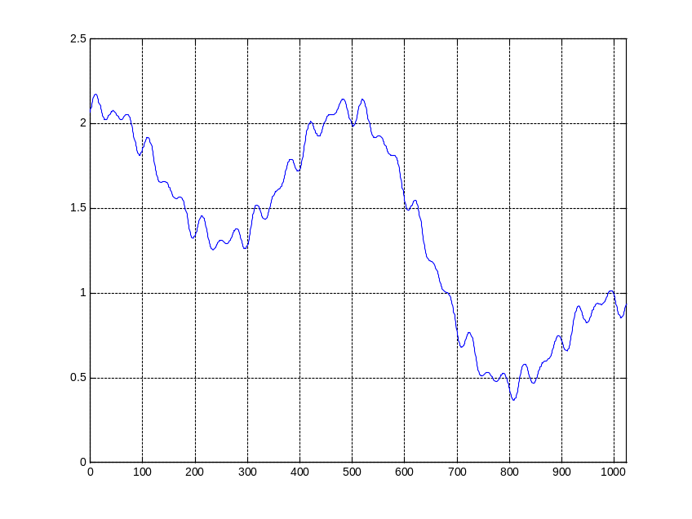
Genetic Algorithm (1) – Search Space
  Most often one is looking for the best solution in a specific subset of solutions.
  This subset is called the search space (or state space).
  Every point in the search space is a possible solution.
  Therefore every point has a fitness value, depending on the problem definition.
  GAs are used to search the search space for the best solution, e.g. a minimum.
  Difficulties are the local minima and the starting point of the search.

Slide 7
Genetic Algorithm (2) – Basic Algorithm
  Starting with a subset of n randomly chosen
  solutions from the search space (i.e. chromosomes).
  This is the population.
  This population is used to produce a next generation of individuals by reproduction.
  Individuals with a higher fitness have more chance to reproduce (i.e. natural selection).

Slide 8
Comparison of Natural and GA Terminology
Natural | Genetic Algorithm
Chromosome Gene Allele Locus Genotype Phenotype | String Feature or character Feature value String position Structure Parameter set, a decoded structure

Slide 9
Genetic Algorithm (3) – Basic Algorithm
  Outline of the basic algorithm
0 START : Create random population of n chromosomes
1 FITNESS : Evaluate fitness f(x) of each chromosome in the population
2 NEW POPULATION
1 REPRODUCTION/SELECTION : Based on f(x)
2 CROSS OVER : Cross-over chromosomes
3 MUTATION : Mutate chromosomes
3 REPLACE : Replace old with new population: the new
generation
4 TEST : Test problem criterium
5 LOOP : Continue step 1 – 4 untill criterium is satisfied

Slide 10
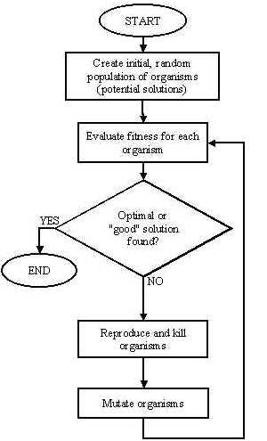
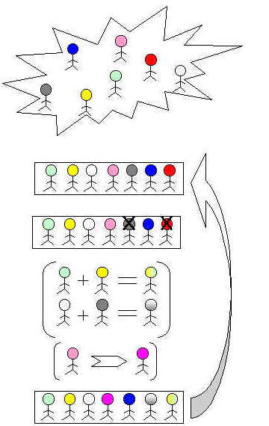

Slide 11
Genetic Algorithm – Coding
  Chromosomes are encoded by bitstrings.
  Every bitstring therefore is a solution but not necessarily the best solution.
  The way bitstrings can code differs from problem to problem.
        Either sequence of on/off or the number 9
1
0
0
1

Slide 12
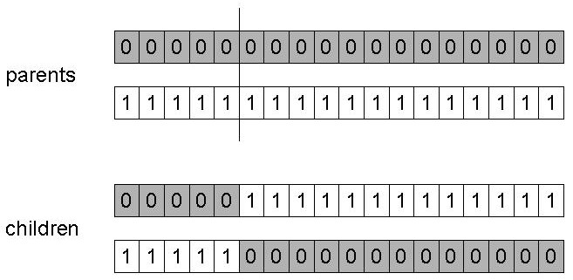
Genetic Algorithm – Crossover (Single Point)
Choose a random point on the two parents.
Split parents at this crossover point.
Create children by exchanging tails.

Slide 13
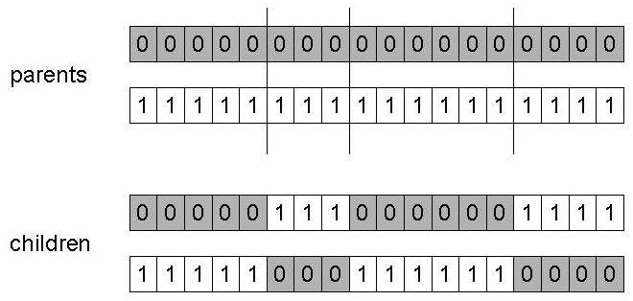
Genetic Algorithm – Crossover (n Points)
Choose n random crossover points.
Split along those points.
Glue parts, alternating between parents.
Generalization of 1 point.

Slide 14
Genetic Algorithm – Uniform Crossover
Generate uniformly random number.
X1 = 0 1 1 0 0 0 1 0 1 0
X2 = 1 1 0 0 0 0 0 1 1 1
Uniformly generated = 1 0 0 0 0 0 1 0 0 0
As a result, the new population becomes,
X1 = 1 1 1 0 0 0 0 0 1 0
X2 = 0 1 0 0 0 0 1 1 1 1

Slide 15
Mutation
Mutation is the addition of new characteristics into the population. With mutation, we randomly try to inject newer characteristics into the population. If these characteristics are good, they will survive and continue into the next population.
Mutation is carried out on a very few individuals, because these are random characteristics that can drive the population anywhere.
The amount of mutation to be carried out is specified by the mutation rate rm, a number between 0 and 1. This number is usually kept low to keep a limited mutation in the algorithm. We iteratethrough each entity in a solution in the population.

Slide 16
Uniform Mutation
Uniform mutation is the most common mutation operation. In this operation, the value at the selected location is simply flipped. Thus if a 0 is present in the location, it changes to 1, and vice versa.
Gaussian Mutation
Gaussian mutation happens in the case of the phenotype representation of the solution, where the solution is represented by simple numerals. In this type of mutation, we add a randomly generated number to the existing value at the selected location.

Slide 17
Genetic Algorithm – An Example
Simple problem: max x² over {0, 1, …, 31}
GA approach:
  Representation: binary code, e.g. 01101 ↔ 13
  Population size: 5
  1-point xover,
  bitwise mutation
One generational cycle performed manually is shown here.

Slide 18
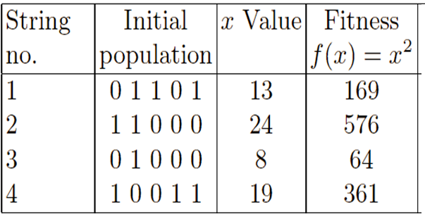
Example : Selection

Slide 19
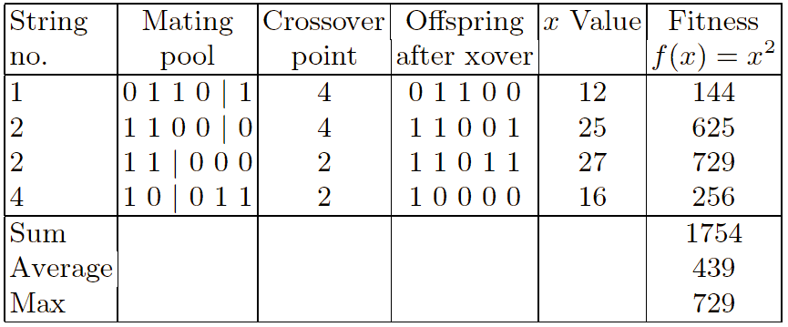
Example : Crossover

Slide 20
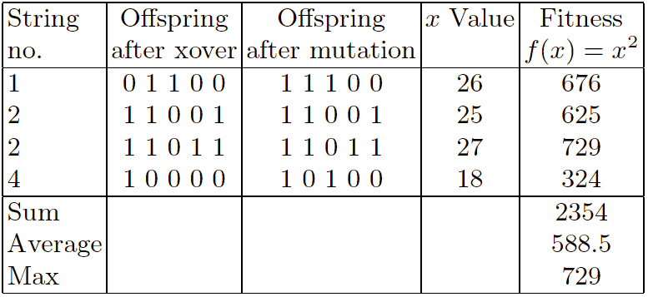
Example : Mutation

Slide 21
Comparison of GA with Traditional Optimization Techniques
GA works with the coding of solution set and not with the solution itself.
GA uses population of solutions rather than a single solution for searching.
GA uses fitness function for evaluation rather the derivatives.
GA uses probabilistic transition and not deterministic rules.

Slide 22
Example
The tutorial starts by presenting the equation that we are going to implement. The equation is shown below:
Y = w1x1 + w2x2 + w3x3 + w4x4 + w5x5 + w6x6
The equation has 6 inputs (x1 to x6) and 6 weights (w1 to w6) as shown and inputs values are (x1,x2,x3,x4,x5,x6)=(4,-2,7,5,11,1). We are looking to find the parameters (weights) that maximize such equation.

Slide 23
Step 1
At first, let us create a list of the 6 inputs and a variable to hold the number of weights as follows:
# Inputs of the equation.
equation_inputs = [4,-2,3.5,5,-11,-4.7]
# Number of the weights we are looking to optimize.
num_weights = 6

Slide 24
Step-2
The next step is to define the initial population. Based on the number of weights, each chromosome (solution or individual) in the population will definitely have 6 genes, one gene for each weight. But the question is how many solutions per the population? There is no fixed value for that and we can select the value that fits well with our problem.
import numpysol_per_pop = 8# Defining the population size.
pop_size = (sol_per_pop,num_weights)
# The population will have sol_per_pop chromosome where each chromosome has num_weights genes.
#Creating the initial population.
new_population = numpy.random.uniform(low=-4.0, high=4.0, size=pop_size)
print(new_population)
After importing the numpy library, we are able to create the initial population randomly using the numpy.random.uniform function. According to the selected parameters, it will be of shape (8, 6). That is 8 chromosomes and each one has 6 genes, one for each weight.

Slide 25
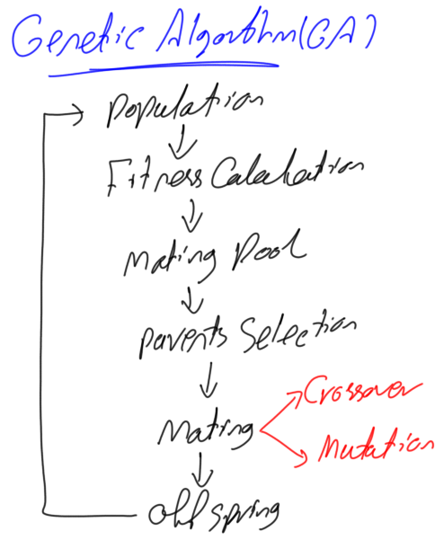
Next Step

Slide 26
program

Slide 27


